Slide 1
Diagrams

Slide 2



Aggregator BM
mFRR capacity market
Schedule
Bids/Orders
Aggregator
Incentive
DSF
End user HEMS

Slide 3
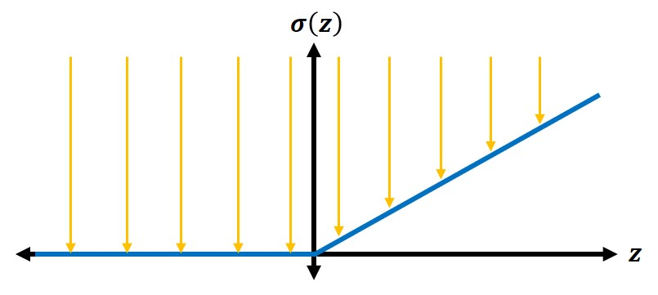


PCAR
$$σ\left(z\right)$$
$$z$$

Slide 4
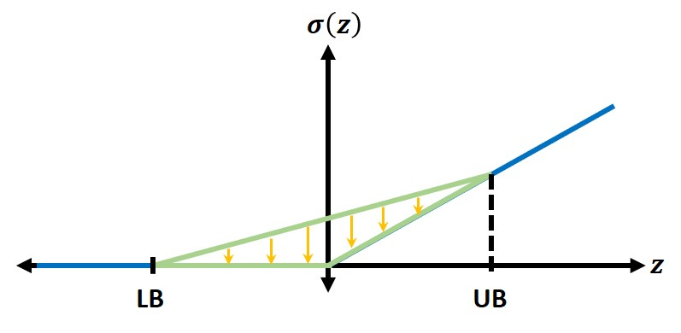


PCTAR
$$σ\left(z\right)$$
$$z$$
LB
UB

Slide 5












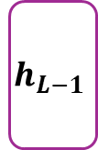







ICNN
$$z$$
$$W_{1}^{(z)}$$
$$h_{1}$$
$$W_{2}$$
$$h_{2}$$
$$W_{3}$$
$$W_{L−1}$$
$$h_{L−1}$$
$$W_{L}$$
$$h_{L}$$
$$W_{L+1}$$
$$y$$
$$…$$
$$W_{2}^{(z)}$$
$$W_{3}^{(z)}$$
$$…$$
$$W_{L−1}^{(z)}$$
$$⋮$$
$$W_{L}^{(z)}$$
$$W_{L+1}^{(z)}$$
Input feedforward path, unrestricted weights
Hidden layer path, non-negative weights

